Slide 1
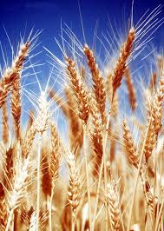
Data Mining in Agriculture
Shweta Garg
Student of MS in Data Science program
The Graduate Center of the City University of New York

Slide 2
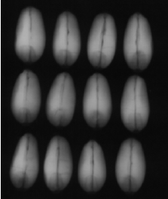
Description of Data Set used in current study
Complete Gradient Clustering Algorithm for Features Analysis of X-Ray Images
M. Charytanowicz et al, Information Technologies in Biomedicine, Springer-Verlag, 2010
Institute of Agrophysics of the Polish Academy of Sciences, Poland
Source : https://archive.ics.uci.edu/ml/datasets/seeds
X-ray Photogram of kernel
Features: (Continuous Variables)
1. Area A 2. Perimeter P 3. Compactness C = 4*pi*A/P^2, 4. Length of kernel, 5. Width of kernel, 6. Asymmetry coefficient 7. Length of kernel groove.

Slide 3
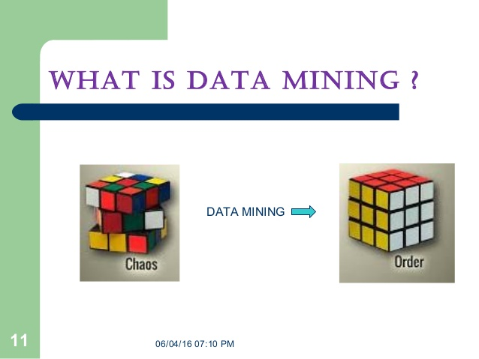
Techniques of Data Mining
Association rule
Clustering
Dimension reduction
Classification

Slide 4
Methods used in this study
Clustering
K-Mean
Hierarchical Clustering
(ii) Classification
Logistic regression
Linear discriminant analysis
Quadratic discriminant analysis
Decision tree
(iii) Dimension reduction
Principal component analysis

Slide 5
How the K-Mean clustering algorithm works?
Start
It partition the n datapoints into
K clusters in which each datapoint belongs
to the cluster with the nearest mean
Number of cluster K
No
Centroid
No point
Moved
Yes
End
Distance to centroids
Assumptions of k-means:
No outlier in the dataset
Data is spherically distributed within clusters
All clusters have almost same size
Data has equal variance of each attribute
Grouping based on min. distance

Slide 6
Hierarchical Clustering
· Agglomerative: Observation starts in its own cluster, and pairs of clusters are merged as one moves up the hierarchy based on some linkage method
· Divisive: All observations start in one cluster, and splits are performed recursively as one moves down the hierarchy based on some linkage method
Linkage Methods:
Single linkage | min { d(x,y) |∃ x∈ C_{i} , y∈ C_{j} } < ε
Complete Linkage | max { d(x,y) |∃ x∈ C_{i} , y∈ C_{j} } < ε
Average Linkage | average distance between any datapoint in different clusters
Ward Linkage | the pair minimize the increase in total within cluster variance.

Slide 7
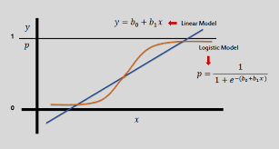
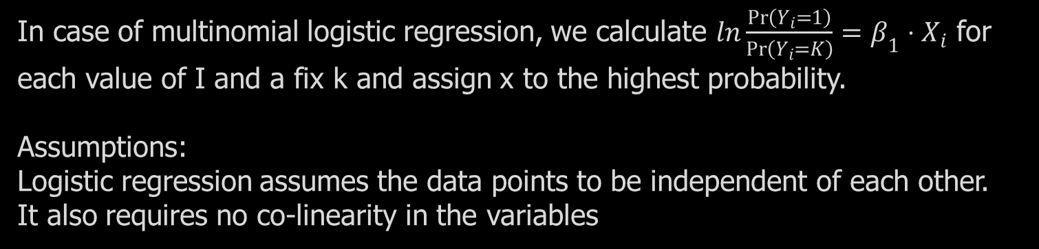
Classification logistic regression
In case of multinomial logistic regression, we calculate $ln\frac{\operatorname{Pr}\left(Y_{i}=1\right)}{\operatorname{Pr}\left(Y_{i}=K\right)}=β_{1}⋅X_{i}$ for each value of I and a fix k and assign x to the highest probability.
Assumptions:
Logistic regression assumes the data points to be independent of each other.
It also requires no co-linearity in the variables

Slide 8
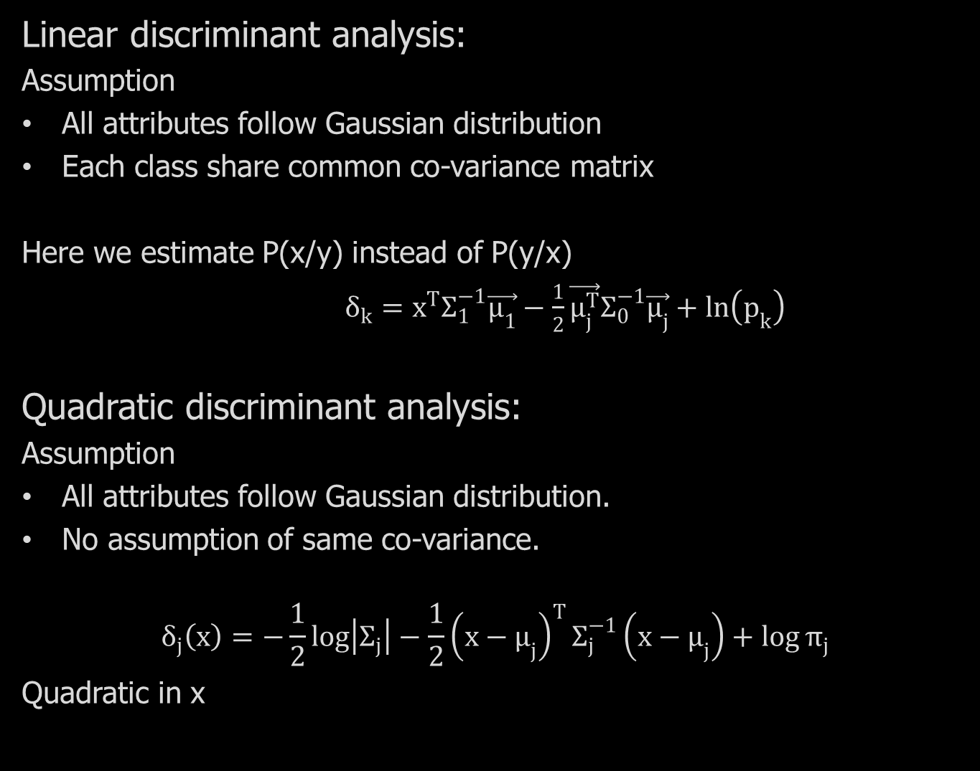
Linear discriminant analysis:
Assumption
All attributes follow Gaussian distribution
Each class share common co-variance matrix
Here we estimate P(x/y) instead of P(y/x)
$δ_{k}=x^{T}Σ_{1}^{−1}\vec{μ_{1}}−\frac{1}{2}\vec{μ_{j}^{T}}Σ_{0}^{−1}\vec{μ_{j}}+ln\left(p_{k}\right)$
Quadratic discriminant analysis:
Assumption
All attributes follow Gaussian distribution.
No assumption of same co-variance.
$$δ_{j}\left(x\right)=−\frac{1}{2}\log\left|Σ_{j}\right|−\frac{1}{2}{\left(x−μ_{j}\right)}^{T}Σ_{j}^{−1}\left(x−μ_{j}\right)+\log{π_{j}}$$
Quadratic in x

Slide 9
Decision Tree
F1
F3
F2
Classify instances by sorting them down from a root to some leaf
Every time it test (if else condition) to branching the tree

Slide 10
Results……..

Slide 11
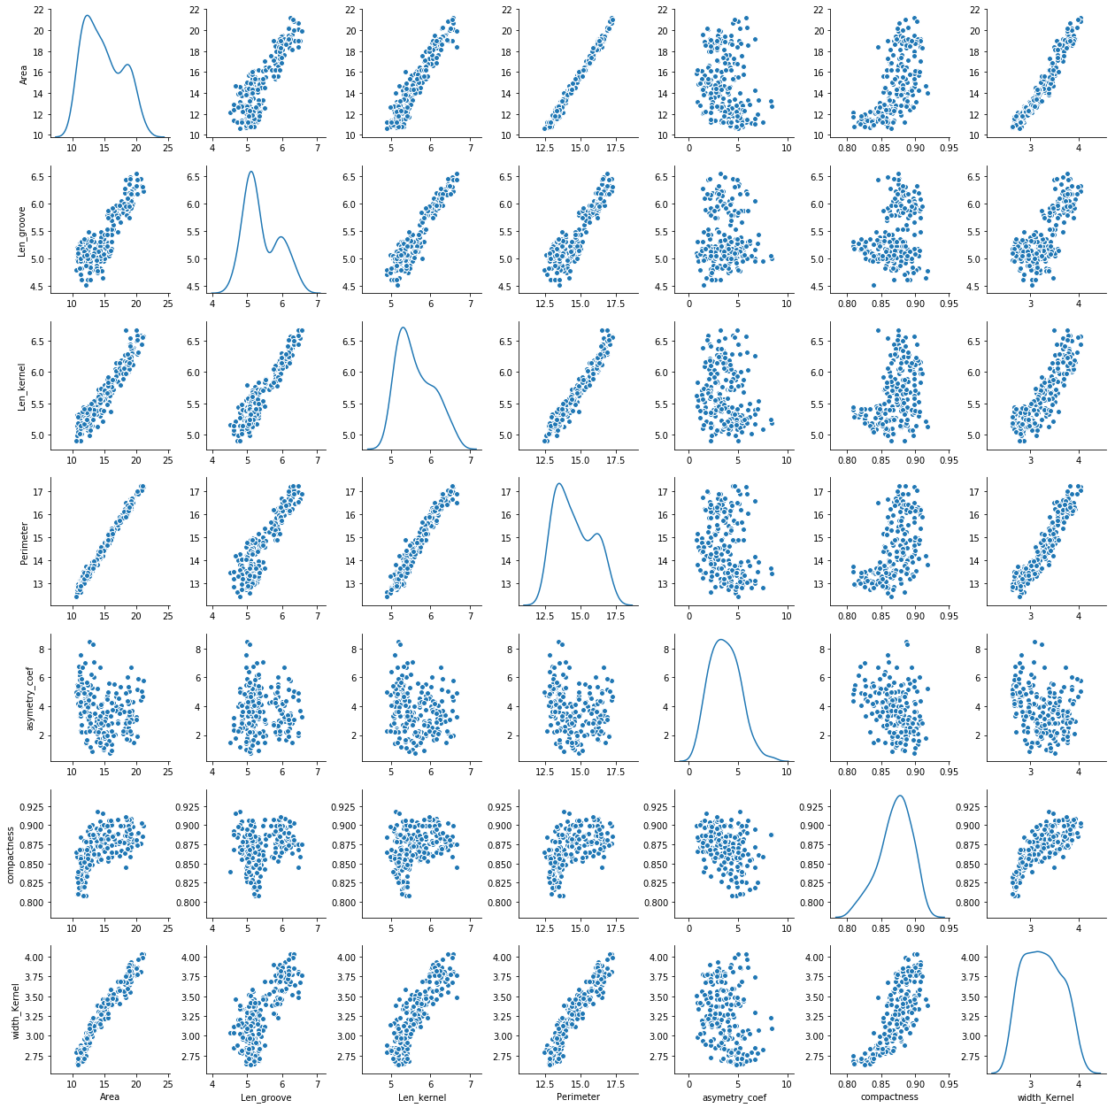
Exploratory Data Analysis
Area
Length of
kernel groove
Length
of kernel
Perimeter
Asymmetry coefficient
Compactness
Width of kernel
Length
of kernel
Asymmetry coefficient
Area
Length of
kernel groove
Perimeter
Width of kernel
Compactness

Slide 12
Exploratory Data Analysis
Area
Length of
kernel groove
Length
of kernel
Perimeter
Asymmetry coefficient
Compactness
Width of kernel
Length
of kernel
Asymmetry coefficient
Area
Length of
kernel groove
Perimeter
Compactness
Width of kernel

Slide 13
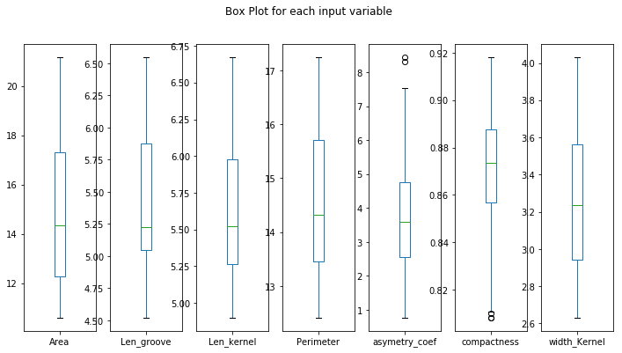
Exploratory Data Analysis…….Contd
EDA | Area | Perimeter | Compactness | Length of Kernel | Width of kernel | Asymmetry Coefficient | Length of Groove
Count | 210 | 210 | 210 | 210 | 210 | 210 | 210
Mean | 14.84752 | 14.559286 | 0.870999 | 5.628533 | 3.258605 | 3.700201 | 5.408071
Std | 2.909699 | 1.305959 | 0.023629 | 0.443063 | 0.377714 | 1.503557 | 0.49148
Min | 10.59 | 12.41 | 0.8081 | 4.899 | 2.63 | 0.7651 | 4.519
25% | 12.27 | 13.45 | 0.8569 | 5.26225 | 2.944 | 2.5615 | 5.045
50% | 14.355 | 14.32 | 0.87345 | 5.5235 | 3.237 | 3.599 | 5.223
75% | 17.305 | 15.715 | 0.887775 | 5.97975 | 3.56175 | 4.76875 | 5.877
Max | 21.18 | 17.25 | 0.9183 | 6.675 | 4.033 | 8.456 | 6.55

Slide 14
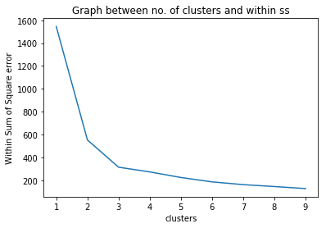
K-Mean clustering
Data preparation for K-Mean
Data Standardization
With outliers K-means:
Class | True Classification | False Classification | Total | % of True Classification
1 | 62 | 8 | 70 | 88.57
2 | 65 | 5 | 70 | 92.85
3 | 66 | 4 | 70 | 94.28
Without outliers K-means:
Class | True Classification | False Classification | Total | % of true classification
1 | 63 | 7 | 70 | 90
2 | 66 | 4 | 70 | 94.28
3 | 62 | 4 | 66 | 93.93

Slide 15
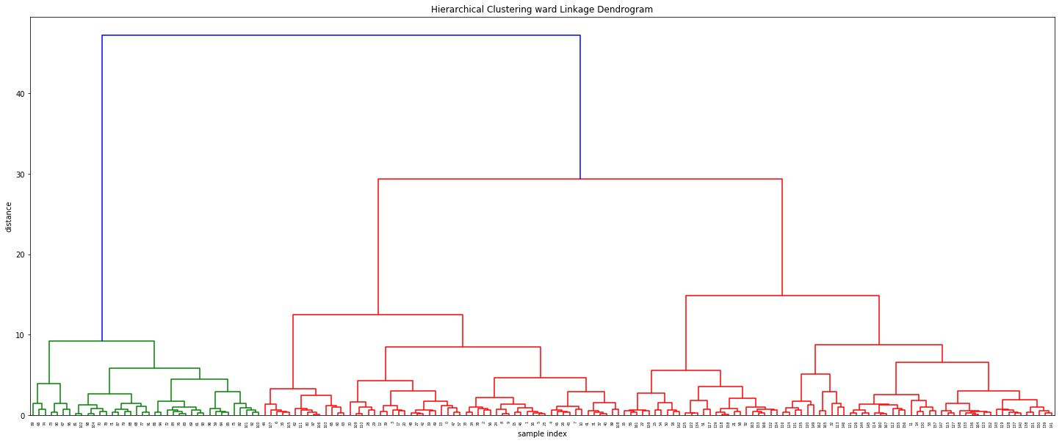
Hierarchical Clustering with ward linkage
Class | True Classification | False Classification | Total | Percent of true classification
1 | 54 | 16 | 70 | 80
2 | 63 | 7 | 70 | 90
3 | 70 | 0 | 70 | 100

Slide 16
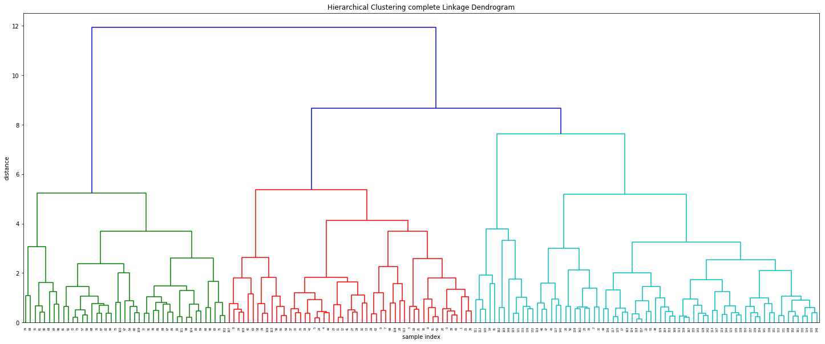
Hierarchical Clustering with complete linkage
Class | True Classification | False Classification | Total | Percent of true classification
1 | 52 | 18 | 70 | 74.28
2 | 47 | 23 | 70 | 67.14
3 | 70 | 0 | 70 | 100

Slide 17
Conclusion…… Mapping the results for agricultural requirements

Slide 18
Hierarchical Clustering with ward linkage
With outliers K-means:
Class | True Classification | False Classification | Total | % of True Classification
1 | 62 | 8 | 70 | 88.57
2 | 65 | 5 | 70 | 92.85
3 | 66 | 4 | 70 | 94.28
Without outliers K-means:
Class | True Classification | False Classification | Total | % of true classification
1 | 63 | 7 | 70 | 90
2 | 66 | 4 | 70 | 94.28
3 | 62 | 4 | 66 | 93.93
Class | True Classification | False Classification | Total | % of true classification
1 | 63 | 7 | 70 | 90
2 | 66 | 4 | 70 | 94.28
3 | 62 | 4 | 66 | 93.93
Class | True Classification | False Classification | Total | Percent of true classification
1 | 54 | 16 | 70 | 80
2 | 63 | 7 | 70 | 90
3 | 70 | 0 | 70 | 100
Class | True Classification | False Classification | Total | Percent of true classification
1 | 54 | 16 | 70 | 80
2 | 63 | 7 | 70 | 90
3 | 70 | 0 | 70 | 100
Hierarchical Clustering with complete linkage
Class | True Classification | False Classification | Total | Percent of true classification
1 | 52 | 18 | 70 | 74.28
2 | 47 | 23 | 70 | 67.14
3 | 70 | 0 | 70 | 100

Slide 19
Visualization of the results by Dimension
reduction method
Principal analysis component:
It is a statistical procedure, which transform a list of possibly correlated variables to linearly independent variables (called principal components).
First two components of PCA
Variance
0.72
0.171
Total=.89
It is covering 89% information of our data.

Slide 20
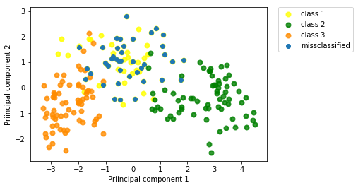
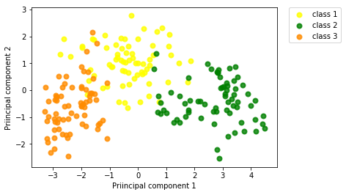
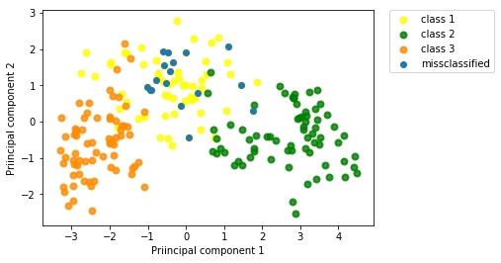
Principal component analysis
Ward Linkage
True labels
K-means

Slide 21
Data preparation for classification
We scaled our dataset
2. Dataset has multicollinearity :
a. Retain area and dropped length of kernel, width of kernel and perimeter (for logistic regression and LDA)
3 Applied 5 - cross validation

Slide 22
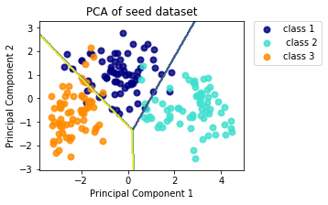
Results: Comparison of different classifier
Classifier | Test set 1 accuracy | Test set 2 accuracy | Test set 3 accuracy | Test set 4 accuracy | Test set 5 accuracy | Result
Logistic regression | .88 | .88 | .95 | .86 | .93 | Inconsistency
LDA | .95 | .95 | .93 | .98 | .95 | .952
QDA | .95 | .90 | 1 | .93 | 1 | Inconsistency
Decision Tree | .88 | .95 | .86 | .93 | .83 | Inconsistency
Decision boundary by LDA
Classifier: LINEAR DISCRIMINANT ANALYSIS

Slide 23
Conclusion
K-means versus Hierarchical clustering ward linkage
Linear discriminant Analysis is the best classifier
Alternative methods of clustering and classification:
Clustering method: Soft K-means, complete gradient method
Classification methods: SVM, random forest, Bootstrap aggregation f
Limitation
May not be a true representative of whole population
Avoid Hierarchical for large dataset

Slide 24
Thank You

